Slide 1
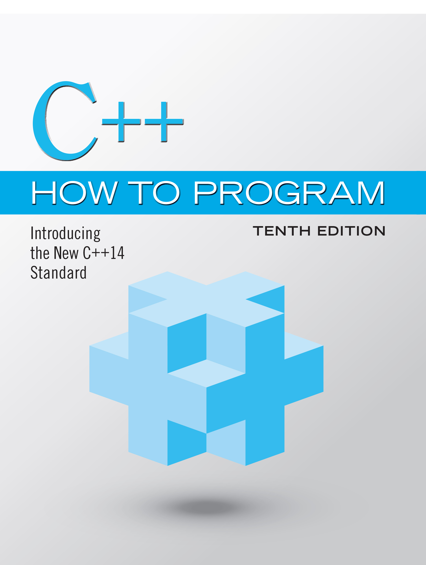
C++ How to Program: Introducing the New C++14 Standard
Tenth Edition
Chapter 5
Control Statements: Part 2; Logical Operators
Copyright © 2017, 2014, 2012 Pearson Education, Inc. All Rights Reserved
Notes:
If this PowerPoint presentation contains mathematical equations, you may need to check that your computer has the following installed:
1) MathType Plugin
2) Math Player (free versions available)
3) NVDA Reader (free versions available)

Slide 2
Learning Objectives (1 of 2)
Learn the essentials of counter-controlled iteration.
Use the for and do…while iteration statements to execute statements in a program repeatedly.
Understand multiple selection using the switch selection statement.
Use the break and continue program-control statements to alter the flow of control.

Slide 3
Learning Objectives (2 of 2)
Use the logical operators to form compound conditions in control statements.
Understand the representational errors associated with using floating-point data types to hold monetary values.
Understand some of the challenges of processing monetary amounts as we begin building a DollarAmount class, which uses integers and integer arithmetic to represent and manipulate monetary amounts.

Slide 4
Outline (1 of 3)
5.1 Introduction
5.2 Essentials of Counter-Controlled Iteration
5.3 for Iteration Statement
5.4 Examples Using the for Statement
5.5 Application: Summing Even Integers
5.6 Application: Compound-Interest Calculations
5.7 Case Study: Integer-Based Monetary Calculations with Class DollarAmount

Slide 5
Outline (2 of 3)
5.7.1 Demonstrating Class DollarAmount
5.7.2 Class DollarAmount
5.8 do…while Iteration Statement
5.9 switch Multiple-Selection Statement
5.10 break and continue Statements
5.10.1 break Statement
5.10.2 continue Statement
5.11 Logical Operators

Slide 6
Outline (3 of 3)
5.11.1 Logical AND (&&) Operator
5.11.2 Logical OR (||) Operator
5.11.3 Short-Circuit Evaluation
5.11.4 Logical Negation (!) Operator
5.11.5 Logical Operators Example
5.12 Confusing the Equality (==) and Assignment (=) Operators
5.13 Structured-Programming Summary
5.14 Wrap-Up

Slide 7
5.1 Introduction (1 of 2)
This chapter continues our presentation of structured-programming theory and principles.
Demonstrates C++’s for, do…while and switch statements.
We explore the essentials of counter-controlled iteration.
We use compound-interest calculations to begin investigating the issues of processing monetary amounts, and we develop a new DollarAmount class that uses very large integers to precisely represent monetary amounts.

Slide 8
5.1 Introduction (2 of 2)
We introduce the break and continue program-control statements.
We discuss C++’s logical operators, which enable you to combine simple conditions in control statements.
We summarize C++’s control statements and the proven problem-solving techniques presented in this chapter and Chapter 4.

Slide 9
5.2 Essentials of Counter-Controlled Iteration (1 of 2)
Counter-controlled iteration requires
a control variable (or loop counter)
the control variable’s initial value
the control variable’s increment that’s applied during each iteration of the loop
the loop-continuation condition that determines if looping should continue.

Slide 10
5.2 Essentials of Counter-Controlled Iteration (2 of 2)
The program in Figure 5.1 prints the numbers from 1 to 10. The declaration in line 8 names the control variable (counter), declares it to be an unsigned int, reserves space for it in memory and sets it to an initial value of 1.
Declarations that require initialization are executable statements.
In C++, it’s more precise to call a declaration that also reserves memory a definition.

Slide 11
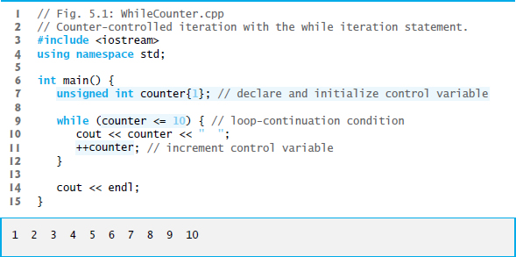
Figure 5.1 Counter-Controlled Iteration with the While Iteration Statement

Slide 12
Error-Prevention Tip 5.1
Floating-point values are approximate, so controlling counting loops with floating-point variables can result in imprecise counter values and inaccurate tests for termination. Control counting loops with integer values.

Slide 13
5.3 For Iteration Statement (1 of 8)
The for iteration statement (Figure 5.2) specifies the counter-controlled iteration details in a single line of code.
The initialization occurs once when the loop is encountered.
The condition is tested next and each time the body completes.
The body executes if the condition is true.
The increment occurs after the body executes.
Then, the condition is tested again.

Slide 14
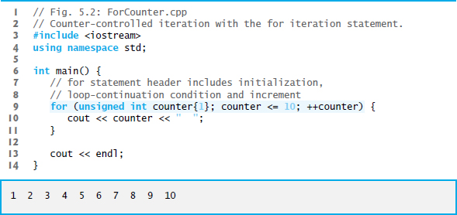
Figure 5.2 Counter-Controlled Iteration with the for Iteration Statement

Slide 15
Common Programming Error 5.1
Using an incorrect relational operator or an incorrect final value of a loop counter in the loop-continuation condition of an iteration statement can cause an off-by-one error.

Slide 16
Error-Prevention Tip 5.2
Using the final value and operator
in a loop’s condition
helps avoid off-by-one errors. For a loop that outputs 1 to 10, the loop-continuation condition should be
rather than counter < 10 (which causes an off-by-one error) or counter < 11 (which is correct). Many programmers prefer so-called zero-based counting, in which to count 10 times, counter would be initialized to zero and the loop-continuation test would be counter < 10.

Slide 17
Error-Prevention Tip 5.3
Write loop conditions carefully to prevent loop counters from overflowing.

Slide 18
5.3 For Iteration Statement (2 of 8)
for Statement Header Components
Figure 5.3 takes a closer look at the for statement header (line 10) of Figure 5.2 see slide 14.

Slide 19
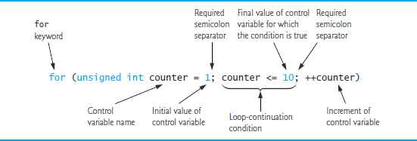
Figure 5.3 For Statement Header Components

Slide 20
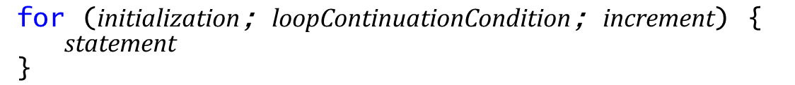
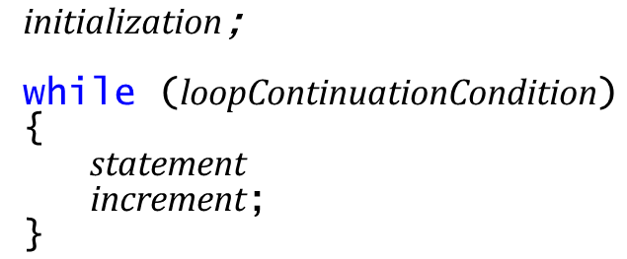
5.3 For Iteration Statement (3 of 8)
The general form of the for statement is
where the initialization expression initializes the loop’s control variable, loopContinuationCondition determines whether the loop should continue executing and increment increments the control variable.
In most cases, the for statement can be represented by an equivalent while statement, as follows:

Slide 21
5.3 For Iteration Statement (4 of 8)
If the initialization expression declares the control variable, the control variable can be used only in the body of the for statement—the control variable will be unknown outside the for statement.
This restricted use of the control variable name is known as the variable’s scope.
The scope of a variable specifies where it can be used in a program.

Slide 22
Common Programming Error 5.2
When a for statement’s control variable is declared in the initialization section of the for’s header, using the control variable after the for’s body is a compilation error.

Slide 23
5.3 For Iteration Statement (5 of 8)
The three expressions in the for statement header are optional (but the two semicolon separators are required).
If the loopContinuationCondition is omitted, C++ assumes that the condition is true, thus creating an infinite loop.
One might omit the initialization expression if the control variable is initialized earlier in the program.
One might omit the increment expression if the increment is calculated by statements in the body of the for or if no increment is needed.

Slide 24
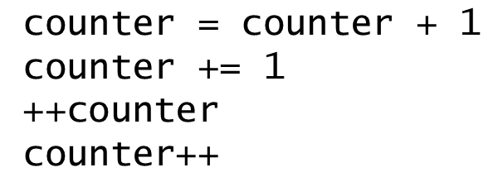
5.3 For Iteration Statement (6 of 8)
The increment expression in the for statement acts like a standalone statement at the end of the for statement’s body.
The expressions
are all equivalent in the increment expression (when no other code appears there).

Slide 25
Common Programming Error 5.3
Placing a semicolon immediately to the right of the right parenthesis of a for header makes that for’s body an empty statement. This is normally a logic error.

Slide 26
Error-Prevention Tip 5.4
Infinite loops occur when the loop-continuation condition in an iteration statement never becomes false. To prevent this situation in a counter-controlled loop, ensure that the control variable is modified during each iteration of the loop so that the loop-continuation condition will eventually become false. In a sentinel-controlled loop, ensure that the sentinel value is able to be input.

Slide 27
5.3 For Iteration Statement (7 of 8)
The initialization, loop-continuation condition and increment expressions of a for statement can contain arithmetic expressions.
The “increment” of a for statement can be negative, in which case it’s really a decrement and the loop actually counts downward.
If the loop-continuation condition is initially false, the body of the for statement is not performed.

Slide 28
Error-Prevention Tip 5.5
Although the value of the control variable can be changed in the body of a for loop, avoid doing so, because this practice can lead to subtle errors. If a program must modify the control variable’s value in the loop’s body, use while rather than for.

Slide 29
5.3 For Iteration Statement (8 of 8)
The for iteration statement’s U M L activity diagram is similar to that of the while statement (Figure 4.6).
Figure 5.4 shows the activity diagram of the for statement in Figure 5.2 see slide 14.
The diagram makes it clear that initialization occurs once before the loop-continuation test is evaluated the first time, and that incrementing occurs each time through the loop after the body statement executes.

Slide 30
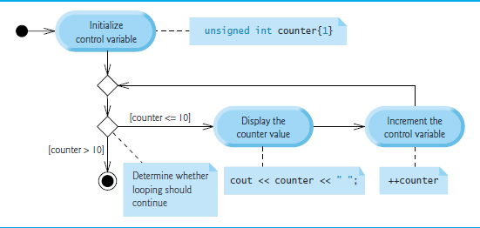
Figure 5.4 U M L Activity Diagram for the for Statement in Figure 5.2 See Slide 14

Slide 31
5.4 Examples Using the for Statement (1 of 2)
Count from 1 to 100 in increments of 1.
Count from 100 down to 1 in decrements of 1.
Count from 7 to 77 in steps of 7.

Slide 32
5.4 Examples Using the for Statement (2 of 2)
Count from 20 down to 2 in steps of -2.
Iterate over the sequence 2, 5, 8, 11, 14, 17, 20.
Iterate over the sequence 99, 88, 77, 66, 55, 44, 33, 22, 11, 0. We use int rather than unsigned int here because the condition does not become false until i’s value is −11, so the control variable must be able to represent both positive and negative values.

Slide 33
Common Programming Error 5.4
Using an incorrect relational operator in the loop-continuation condition of a loop that counts downward (e.g., using
in a loop counting down to 1) is usually a logic error.

Slide 34
Common Programming Error 5.5
Do not use equality operators
in a loop-continuation condition if the loop’s control variable increments or decrements by more than 1. For example, consider the for statement header
The loop-continuation test
never becomes
false (resulting in an infinite loop) because counter increments by 2 after each iteration (and never becomes 10).

Slide 35
5.5 Application: Summing Even Integers
The program of Figure 5.5 uses a for statement to sum the even integers from 2 to 20.

Slide 36
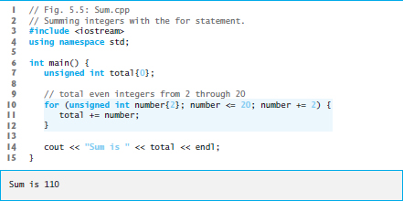
Figure 5.5 Summing Integers with the for Statement

Slide 37
Good Programming Practice 5.1
Place only expressions involving the control variables in the initialization and increment sections of a for statement.

Slide 38
Good Programming Practice 5.2
For readability limit the size of control-statement headers to a single line if possible.

Slide 39
5.6 Application: Compound-Interest Calculations (1 of 11)
Consider the following problem statement:
A person invests $1000.00 in a savings account yielding 5% interest. Assuming that all interest is left on deposit in the account, calculate and print the amount of money in the account at the end of each year for 10 years. Use the following formula for determining these amounts:
where p is the original amount invested (i.e., the principal), r is the annual interest rate, n is the number of years and a is the amount on deposit at the end of the nth year.
This problem involves a loop that performs the indicated calculation for each of the 10 years the money remains on deposit (Figure 5.6).

Slide 40
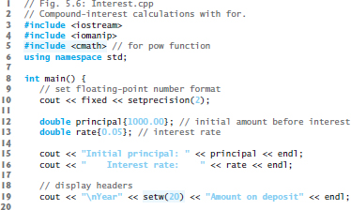
Figure 5.6 Compound-Interest Calculations with For (1 of 2)

Slide 41
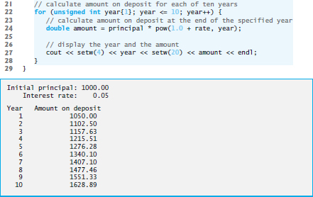
Figure 5.6 Compound-Interest Calculations with For (2 of 2)

Slide 42
5.6 Application: Compound-Interest Calculations (2 of 11)
Using Stream Manipulators to Format Numeric Output
Parameterized stream manipulators setprecision and setw and the nonparameterized stream manipulator fixed.
The stream manipulator setw(4) specifies that the next value output should appear in a field width of 4—i.e., cout prints the value with at least 4 character positions.
If less than 4 character positions wide, the value is right justified in the field by default.
If more than 4 character positions wide, the field width is extended rightward to accommodate the entire value.
To indicate that values should be output left justified, simply output nonparameterized stream manipulator left.
Right justification can be restored by outputting nonparameterized stream manipulator right.

Slide 43
5.6 Application: Compound-Interest Calculations (3 of 11)
Stream manipulator fixed indicates that floating-point values should be output as fixed-point values with decimal points.
Stream manipulator setprecision specifies the number of digits to the right of the decimal point.
Stream manipulators fixed and setprecision remain in effect until they’re changed—such settings are called sticky settings.
The field width specified with setw applies only to the next value output.

Slide 44
5.6 Application: Compound-Interest Calculations (4 of 11)
C++ does not include an exponentiation operator, so we use the standard library function pow.
pow(x, y) calculates the value of x raised to the
power.
Takes two arguments of type double and returns a double value.
This program will not compile without including header file <cmath>.
Includes information that tells the compiler to convert the value of year to a temporary double representation before calling the function.
Contained in pow’s function prototype.

Slide 45
Performance Tip 5.1
In loops, avoid calculations for which the result never changes—such calculations should typically be placed before the loop. Many of today’s sophisticated optimizing compilers will place such calculations before loops in the compiled code.

Slide 46
5.6 Application: Compound-Interest Calculations (5 of 11)
Variables of type float represent single-precision floating-point numbers and have approximately seven significant digits on most of today’s systems.
Variables of type double represent double-precision floating-point numbers.
These require twice as much memory as float variables and provide approximately 15 significant digits on most of today’s systems—approximately double the precision of float variables.

Slide 47
5.6 Application: Compound-Interest Calculations (6 of 11)
Most programmers represent floating-point numbers with type double.
C++ treats all floating-point numbers you type in a program’s source code (such as 7.33 and 0.0975) as double values by default.
Such values in the source code are known as floating-point literals.

Slide 48
5.6 Application: Compound-Interest Calculations (7 of 11)
In conventional arithmetic, floating-point numbers often arise as a result of division—when we divide 10 by 3, the result is 3.3333333…, with the sequence of 3s repeating infinitely.
The computer allocates only a fixed amount of space to hold such a value, so clearly the stored floating-point value can be only an approximation.
double suffers from what we call representational error.

Slide 49
Common Programming Error 5.6
Using floating-point numbers in a manner that assumes they’re represented exactly (e.g., using them in comparisons for equality) can lead to incorrect results. Floating-point numbers are represented only approximately.

Slide 50
5.6 Application: Compound-Interest Calculations (8 of 11)
Floating-point numbers have numerous applications, especially for measured values.
E.g., a “normal” body temperature of 98.6 degrees Fahrenheit does not need to be precise to a large number of digits. 98.6 may actually be 98.5999473210643. Calling this number simply 98.6 is fine for most applications involving body temperatures.
Due to the imprecise nature of floating-point numbers, type double is preferred over type float, because double variables can represent floating-point numbers more precisely.

Slide 51
5.6 Application: Compound-Interest Calculations (9 of 11)
Simple explanation of what can go wrong when using double (or float) to represent dollar amounts (assuming that dollar amounts are displayed with two digits to the right of the decimal point):
Two calculated double dollar amounts stored in the machine could be 14.234 (which would normally be rounded to 14.23 for display purposes) and 18.673 (which would normally be rounded to 18.67 for display purposes).

Slide 52
5.6 Application: Compound-Interest Calculations (10 of 11)
When these amounts are added, they produce the internal sum 32.907, which would normally be rounded to 32.91 for display purposes. Thus, your output could appear as
A person adding the individual numbers as displayed would expect the sum to be 32.90.

Slide 53
Error-Prevention Tip 5.6
Do not use variables of type double (or float) to perform precise monetary calculations. The imprecision of floating-point numbers can lead to errors.

Slide 54
5.6 Application: Compound-Interest Calculations (11 of 11)
Even simple dollar amounts can have representational errors when they’re stored as doubles.
We created a simple program with the declaration
Double d = 123.02;
Then displayed variable d’s value with many digits of precision to the right of the decimal.
The resulting output showed 123.02 as 123.0199999…, which is another example of a representational error.

Slide 55
5.7 Integer-Based Monetary Calculations with Class DollarAmount (1 of 22)
In Chapter 3, we developed an Account class.
A typical dollar Account balance—such as $437.19—has a whole number of dollars (e.g., 437) to the left of the decimal point and a whole number of cents (e.g., 19) to the right.
For simplicity, class Account represented its balance with type int, which of course limited balances to whole dollar amounts.

Slide 56
5.7 Integer-Based Monetary Calculations with Class DollarAmount (2 of 22)
Figure 5.6’s compound-interest example processed dollar amounts as type double
Representational errors, because we stored precise decimal dollar amounts and interest rates as doubles.
Can avoid these by performing all calculations using integer arithmetic—even interest calculations.
Rounding of the floating-point values.
We cannot avoid rounding on interest calculations, because they result in fractional pennies when working with dollar amounts. Those fractional pennies must be rounded to the hundredths place.
With integer arithmetic we can exercise precise control over rounding without suffering the representational errors associated with floating-point calculations.

Slide 57
5.7 Integer-Based Monetary Calculations with Class DollarAmount (3 of 22)
Many points in monetary calculations in which rounding may occur.
For example, on a restaurant bill, the tax could be calculated on each individual item, resulting in many separate rounding operations, or it could be calculated only once on the total bill amount—these alternate approaches could yield different results.
Performing monetary calculations with doubles can cause problems for organizations that require precise dollar amounts—such as banks, insurances companies and businesses in general.

Slide 58
5.7 Integer-Based Monetary Calculations with Class DollarAmount (4 of 22)
We’ll create a DollarAmount class for precise control over monetary amounts.
Represents dollar amounts in whole numbers of pennies—for example, $1,000 is stored as 100000.
A key benefit of this approach is that integer values are represented exactly in memory.

Slide 59
5.7 Integer-Based Monetary Calculations with Class DollarAmount (5 of 22)
DollarAmount capabilities
a constructor to initialize a DollarAmount object to a whole number of pennies
an add member function that adds DollarAmounts
a subtract member function that subtracts DollarAmounts
an addInterest member function that calculates annual interest on the amount in the DollarAmount object on which the function is called and adds the interest to the amount in that object
a toString member function that returns a DollarAmount’s string representation.

Slide 60
5.7 Integer-Based Monetary Calculations with Class DollarAmount (6 of 22)
All calculations use integer arithmetic
no floating-point calculations are used, so DollarAmounts always represent their values precisely.
Reimplement Figure 5.6’s compound-interest example using DollarAmounts.
Then we’ll present the class and walk through the code.
Class DollarAmount will control precisely how that rounding occurs using integer arithmetic.

Slide 61
5.7 Integer-Based Monetary Calculations with Class DollarAmount (7 of 22)
Figure 5.7 adds DollarAmounts, subtracts DollarAmounts and calculates compound interest with DollarAmounts to demonstrate the class’s capabilities.

Slide 62
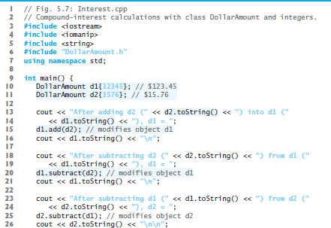
Figure 5.7 Compound-Interest Calculations with Class DollarAmount and Integers (1 of 4)

Slide 63
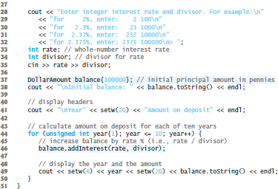
Figure 5.7 Compound-Interest Calculations with Class DollarAmount and Integers (2 of 4)

Slide 64
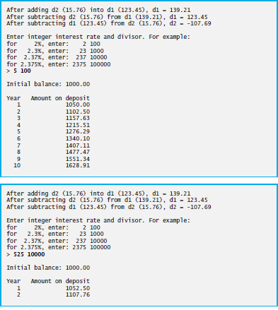
Figure 5.7 Compound-Interest Calculations with Class DollarAmount and Integers (3 of 4)

Slide 65

Figure 5.7 Compound-Interest Calculations with Class DollarAmount and Integers (4 of 4)

Slide 66
5.7 Integer-Based Monetary Calculations with Class DollarAmount (8 of 22)
addInterest member function receives two arguments:
an integer representation of the interest rate and
an integer divisor (a power of 10)
To determine the interest amount, addInterest multiplies the DollarAmount object’s number of pennies by the integer representation of the interest rate, then divides the result by the integer divisor.

Slide 67
5.7 Integer-Based Monetary Calculations with Class DollarAmount (9 of 22)
For example:
To calculate 5% interest, enter the integers 5 and 100. In integer arithmetic, multiplying a DollarAmount by 5, then dividing the result by 100 calculates 5% of the DollarAmount’s value.
To calculate 5.25% interest, enter the integers 525 and 10000. In integer arithmetic, multiplying a DollarAmount by 525, then dividing the result by 10000 calculates 5.25% of the DollarAmount’s value.

Slide 68
5.7 Integer-Based Monetary Calculations with Class DollarAmount (10 of 22)
Figure 5.8 defines class DollarAmount with data member amount (line 41) representing an integer number of pennies.

Slide 69
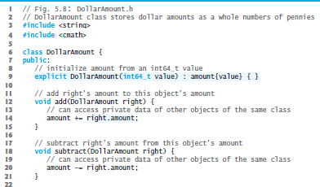
Figure 5.8 DollarAmount Class Stores Dollar Amounts as Whole Numbers of Pennies (1 of 2)

Slide 70
Figure 5.8 DollarAmount Class Stores Dollar Amounts as Whole Numbers of Pennies (2 of 2)

Slide 71
5.7 Integer-Based Monetary Calculations with Class DollarAmount (11 of 22)
On most computers, an int’s range is
–2,147,483,647 to 2,147,483,647
This would limit a DollarAmount to approximately ±$21 million
too small for many monetary applications
C++11’s long long type
–9,223,372,036,854,775,808 to 9,223,372,036,854,775,807 as a minimum
±$92 quadrillion, likely more than enough for every known monetary application.

Slide 72
5.7 Integer-Based Monetary Calculations with Class DollarAmount (12 of 22)
The range of long long (and C++’s other integer types) can vary across platforms.
For portability, C++11 introduced new integer-type names so you can choose the appropriate range of values for your program.
int64_t supports the exact range
–9,223,372,036,854,775,808 to 9,223,372,036,854,775,807
For a list of C++11’s other new integer-type names, see the header <cstdint>.

Slide 73
5.7 Integer-Based Monetary Calculations with Class DollarAmount (13 of 22)
The add member function (line 12–15) receives another DollarAmount object as an argument and adds its value to the DollarAmount object on which add is called.
Line 14 uses the += operator to add right.amount (that is, the amount in the argument object) to the current object’s amount, thus modifying the object.

Slide 74
5.7 Integer-Based Monetary Calculations with Class DollarAmount (14 of 22)
The expression right.amount accesses the private amount data member in the object right.
This is a special relationship among objects of the same class—a member function of a class can access both the private data of the object on which that function is called and the private data of other objects of the same class that are passed to the function.
subtract (lines 18–21) works similarly to add, but uses the -= operator to subtract right.amount from the current object’s amount.

Slide 75
5.7 Integer-Based Monetary Calculations with Class DollarAmount (15 of 22)
addInterest (line 25–32) performs the interest calculation using its rate and divisor parameters, then adds the interest to the amount.
Interest calculations normally yield fractional results that require rounding.
We perform only integer arithmetic calculations with integer results here, so we completely avoid the representational error of double, but as you’ll see, rounding is still required.

Slide 76
5.7 Integer-Based Monetary Calculations with Class DollarAmount (16 of 22)
For this example, we use half-up rounding.
First, consider rounding the floating-point values 0.75 and 0.25 to the nearest integer. Using half-up rounding, values .5 and higher should round up and everything else should round down, so 0.75 rounds up to 1 and 0.25 rounds down to 0.

Slide 77
5.7 Integer-Based Monetary Calculations with Class DollarAmount (17 of 22)
Consider rounding an integer interest calculation. Assume that we’re calculating 5% interest on $10.75.
We treat 10.75 as 1075, and to calculate 5% interest, we multiply by 5, then divide by 100.
In the interest calculation, we first multiply 1075 by 5, yielding the integer value 5375, which represents 53 whole pennies and 75 hundredths of a penny.
In this case, the 75 hundredths of a penny should round up to a whole penny, resulting in 54 whole pennies.
More generally:
50 to 99 hundredths should round up to the next higher whole penny
1 to 49 hundredths should round down to the next lower whole penny.

Slide 78
5.7 Integer-Based Monetary Calculations with Class DollarAmount (18 of 22)
If we divide 5375 by 100 to complete the interest calculation, the result is 53, which is incorrect
integer arithmetic truncates
To fix this, add 50 to ensure that 50 to 99 hundredths round up. For example:
5350 + 50 yields 5400—dividing that by 100 yields 54
5375 + 50 yields 5425—dividing that by 100 yields 54
5399 + 50 yields 5449—dividing that by 100 yields 54
Similarly:
5301 + 50 yields 5351—dividing that by 100 yields 53
5325 + 50 yields 5375—dividing that by 100 yields 53
5349 + 50 yields 5399—dividing that by 100 yields 53

Slide 79
5.7 Integer-Based Monetary Calculations with Class DollarAmount (19 of 22)
The following calculation performs the half-up rounding described above:
Rather than adding 50, we add divisor / 2.
Adding 50 is correct when the divisor is 100, but for other divisors, this would not round to the correct digit.
Consider 5.25% interest on $10.75. In integer arithmetic, we treat 10.75 as 1075, and to calculate 5.25% interest, we multiply by 525, then divide by 10000. We first multiply 1075 by 525, yielding the integer value 564375, which represents 56 whole pennies and 4375 ten-thousandths of a penny. This should round down to 56 whole pennies. To round correctly, in this case, we need to add 5000—that is, half of the divisor 10000.

Slide 80
5.7 Integer-Based Monetary Calculations with Class DollarAmount (20 of 22)
After the interest is calculated, line 31 calls member function add, passing the new DollarAmount object interest as an argument—this updates the amount in the DollarAmount object on which addInterest was called.
Any member function of a class can call any other directly to perform operations on the same object of the class.

Slide 81
5.7 Integer-Based Monetary Calculations with Class DollarAmount (21 of 22)
The toString member function (line 35–39) returns a DollarAmount’s string representation
C++ Standard Library function to_string (from header <string>) converts a numeric value to a string object.
C++ Standard Library function abs (from header <cmath>) gets the absolute value of a number.
“adding” string literals and string objects using the + operator is known as string concatenation.
string member function size returns the number of characters in a string cents.

Slide 82
5.7 Integer-Based Monetary Calculations with Class DollarAmount (22 of 22)
Half-up rounding is a biased technique—fractional amounts of .1, .2, .3 and .4 round down, and .5, .6, .7, .8 and .9 round up.
Four values round down and five round up.
Because more values round up than down, this can lead to discrepancies in monetary calculations.
Banker’s rounding fixes this problem by rounding .5 to the nearest even integer
0.5 rounds to 0, 1.5 and 2.5 round to 2, 3.5 and 4.5 round to 4, etc.

Slide 83
5.8 Do…While Iteration Statement (1 of 2)
Similar to the while statement.
The do…while statement tests the loop-continuation condition after the loop body executes; therefore, the loop body always executes at least once.
Figure 5.9 uses a do…while statement to print the numbers 1–10.

Slide 84
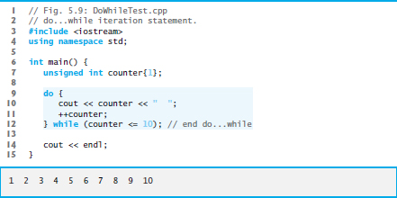
Figure 5.9 Do…While Iteration Statement

Slide 85
5.8 Do…While Iteration Statement (2 of 2)
do…while Statement U M L Activity Diagram
Figure 5.10 contains the do…while statement’s U M L activity diagram, which makes it clear that the loop-continuation condition is not evaluated until after the loop performs its body at least once.

Slide 86
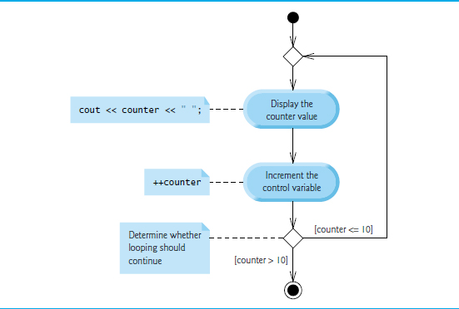
Figure 5.10 Do…While Iteration Statement U M L Activity Diagram

Slide 87
5.9 Switch Multiple-Selection Statement (1 of 8)
The switch multiple-selection statement performs many different actions based on the possible values of a variable or expression.
Each action is associated with the value of an integral constant expression (i.e., any combination of character and integer constants that evaluates to a constant integer value).
Figure 5.11 calculates the class average of a set of numeric grades entered by the user, and uses a switch statement to determine whether each grade is the equivalent of an A, B, C, D or F and to increment the appropriate grade counter.

Slide 88
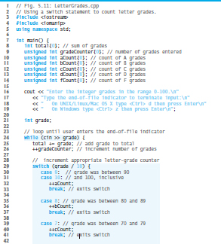
Figure 5.11 Using a Switch Statement to Count Letter Grades (1 of 3)

Slide 89
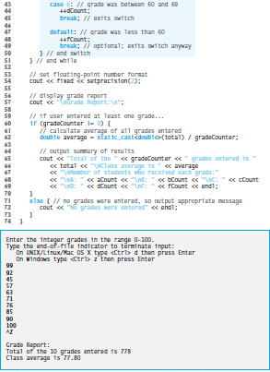
Figure 5.11 Using a Switch Statement to Count Letter Grades (2 of 3)

Slide 90
Figure 5.11 Using a Switch Statement to Count Letter Grades (3 of 3)

Slide 91
5.9 Switch Multiple-Selection Statement (2 of 8)
Lines 16–19 prompt the user to enter integer grades or type the end-of-file indicator to terminate the input.
The end-of-file indicator is a system-dependent keystroke combination used to indicate that there’s no more data to input.
In Chapter 14, File Processing, you’ll see how the end-of-file indicator is used when a program reads its input from a file.

Slide 92
5.9 Switch Multiple-Selection Statement (3 of 8)
On U N I X/Linux/Mac O S X systems, end-of-file is entered by typing the following sequence on a line by itself
<C t r l> d
This notation means to simultaneously press both the Ctrl key and the d key.
On Windows systems, end-of-file can be entered by typing
<C t r l> z
Windows typically displays the characters ^Z on the screen in response to this key combination

Slide 93
Portability Tip 5.1
The keystroke combinations for entering end-of-file are system dependent.

Slide 94
5.9 Switch Multiple-Selection Statement (4 of 8)
The switch statement consists of a series of case labels and an optional default case.
When the flow of control reaches the switch, the program evaluates the controlling expression in the parentheses.
Compares the value of the controlling expression with each case label.
If a match occurs, the program executes the statements for that case.
The break statement causes program control to proceed with the first statement after the switch.

Slide 95
5.9 Switch Multiple-Selection Statement (5 of 8)
Listing cases consecutively with no statements between them enables the cases to perform the same set of statements.
Each case can have multiple statements.
The switch selection statement does not require braces around multiple statements in each case.
Without break statements, each time a match occurs in the switch, the statements for that case and subsequent cases execute until a break statement or the end of the switch is encountered.
Referred to as “falling through” to the statements in subsequent cases.

Slide 96
Common Programming Error 5.7
Forgetting a break statement when one is needed in a switch is a logic error.

Slide 97
5.9 Switch Multiple-Selection Statement (6 of 8)
If no match occurs between the controlling expression’s value and a case label, the default case executes.
If no match occurs in a switch statement that does not contain a default case, program control continues with the first statement after the switch.

Slide 98
Error-Prevention Tip 5.7
In a switch, ensure that you test for all possible values of the controlling expression.

Slide 99
5.9 Switch Multiple-Selection Statement (7 of 8)
Figure 5.12 shows the U M L activity diagram for the general switch multiple-selection statement.
Most switch statements use a break in each case to terminate the switch statement after processing the case.
Figure 5.12 emphasizes this by including break statements in the activity diagram.
Without the break statement, control would not transfer to the first statement after the switch statement after a case is processed.
Instead, control would transfer to the next case’s actions.
The diagram makes it clear that the break statement at the end of a case causes control to exit the switch statement immediately.

Slide 100
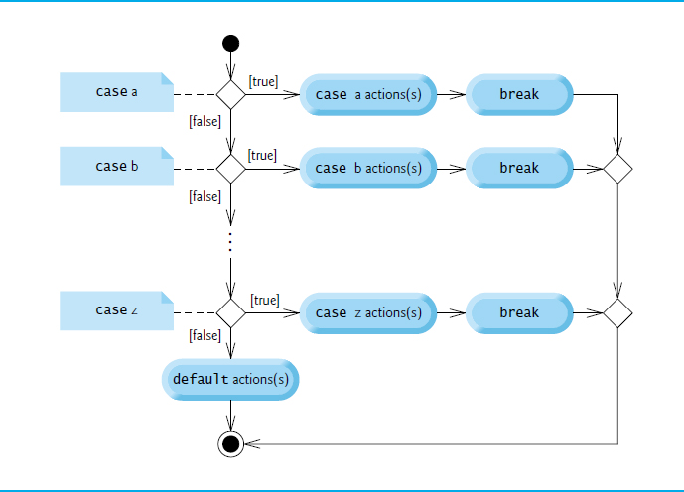
Figure 5.12 Switch Multiple-Selection Statement U M L Activity Diagram with Break Statements

Slide 101
Error-Prevention Tip 5.8
Provide a default case in switch statements. This focuses you on the need to process exceptional conditions.

Slide 102
Good Programming Practice 5.3
Although each case and the default case in a switch can occur in any order, place the default case last. When the default case is listed last, the break for that case is not required.

Slide 103
5.9 Switch Multiple-Selection Statement (8 of 8)
case values
An integer constant is simply an integer value.
In addition, you can use character constants—specific characters in single quotes, such as 'A', '7' or '$'—which represent the integer values of characters and enum constants (introduced in Section 6.8). (Appendix B shows the integer values of the characters in the A S C I I character set, which is a subset of the Unicode® character set.)
The expression in each case also can be a constant variable—a variable containing a value which does not change for the entire program.
Such a variable is declared with keyword const

Slide 104
5.10 Break and Continue Statements
In addition to selection and iteration statements, C++ provides statements break (which we discussed in the context of the switch statement) and continue to alter the flow of control.

Slide 105
5.10.1 Break Statement
The break statement, when executed in a while, for, do…while or switch statement, causes immediate exit from that statement.
Program execution continues with the next statement.
Common uses of the break statement are to escape early from a loop or to skip the remainder of a switch statement.
Figure 5.13 demonstrates the break statement (line 13) exiting a for iteration statement.

Slide 106
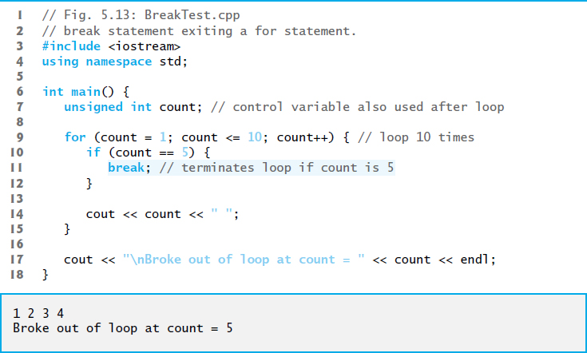
Figure 5.13 Break Statement Exiting a for Statement

Slide 107
5.10.2 Continue Statement
The continue statement, when executed in a while, for or do…while statement, skips the remaining statements in the body of that statement and proceeds with the next iteration of the loop.
In while and do…while statements, the loop-continuation test evaluates immediately after the continue statement executes.
In the for statement, the increment expression executes, then the loop-continuation test evaluates.

Slide 108
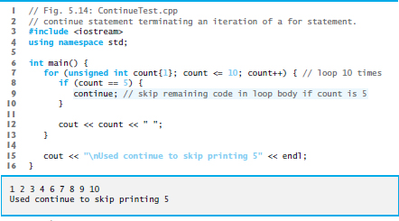
Figure 5.14 Continue Statement Terminating an Iteration of a for Statement

Slide 109
Software Engineering Observation 5.1
Some programmers feel that break and continue violate structured programming. Since the same effects are achievable with structured-programming techniques, these programmers do not use break or continue.

Slide 110
Software Engineering Observation 5.2
There’s a tension between achieving quality software engineering and achieving the bestperforming software. Sometimes one of these goals is achieved at the expense of the other. For all but the most performance-intensive situations, apply the following rule of thumb: First, make your code simple and correct; then make it fast and small, but only if necessary.

Slide 111
5.11 Logical Operators (1 of 2)
C++ provides logical operators that are used to form more complex conditions by combining simple conditions.
The logical operators are && (logical AND), || (logical OR) and ! (logical NOT, also called logical negation).

Slide 112
5.11.1 Logical and (&&) Operator
The && (logical AND) operator is used to ensure that two conditions are both true before we choose a certain path of execution.
The simple condition to the left of the && operator evaluates first.
If necessary, the simple condition to the right of the && operator evaluates next.
The right side of a logical AND expression is evaluated only if the left side is true.

Slide 113
5.11 Logical Operators (2 of 2)
Figure 5.15 summarizes the && operator.
The table shows all four possible combinations of false and true values for expression1 and expression2.
Such tables are often called truth tables.
C++ evaluates to false or true all expressions that include relational operators, equality operators and/or logical operators.

Slide 114
Figure 5.15 && (Logical and) Operator Truth Table
expression1 | expression2 | expression1 && expression2
false | false | false
false | true | false
true | false | false
true | true | true

Slide 115
5.11.2 Logical or (||) Operator
The || (logical OR) operator determines if either or both of two conditions are true before we choose a certain path of execution.
Figure 5.16 is a truth table for the logical OR operator (||).
The && operator has a higher precedence than the || operator.
Both operators associate from left to right.

Slide 116
Figure 5.16 || (Logical or) Operator Truth Table
expression1 | expression2 | expression1 || expression2
false | false | false
false | true | true
true | false | true
true | true | true

Slide 117
5.11.3 Short-Circuit Evaluation
An expression containing && or || operators evaluates only until the truth or falsehood of the expression is known.
This performance feature for the evaluation of logical AND and logical OR expressions is called short-circuit evaluation.

Slide 118
Common Programming Error 5.8
In expressions using operator &&, a condition—we’ll call this the dependent condition—may require another condition to be true for the evaluation of the dependent condition to be meaningful. In this case, the dependent condition should be placed after the && operator to prevent errors. Consider the expression (i != 0) && (10 / i == 2). The dependent condition (10 / i == 2) must appear after the && operator to prevent the possibility of division by zero.

Slide 119
5.11.4 Logical Negation (!) Operator
The ! (logical negation, also called logical NOT or logical complement) operator “reverses” the meaning of a condition.
Unlike the logical operators && and ||, which are binary operators that combine two conditions, the logical negation operator is a unary operator that has only one condition as an operand.
Figure 5.17 is a truth table for the logical negation operator.

Slide 120
Figure 5.17 ! (Logical Negation) Operator Truth Table
expression | ! expression
false | true
true | false

Slide 121
5.11.5 Logical Operators Example (1 of 2)
Figure 5.18 demonstrates the logical operators by producing their truth tables.
The output shows each expression that is evaluated and its bool result.
By default, bool values true and false are displayed by cout and the stream insertion operator as 1 and 0, respectively.
Stream manipulator boolalpha (a sticky manipulator) specifies that the value of each bool expression should be displayed as either the word “true” or the word “false.”

Slide 122
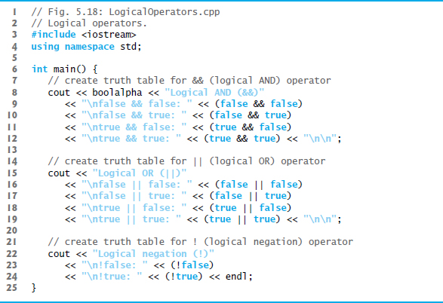
Figure 5.18 Logical Operators (1 of 2)

Slide 123
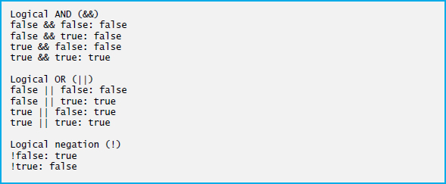
Figure 5.18 Logical Operators (2 of 2)

Slide 124
5.11.5 Logical Operators Example (2 of 2)
Figure 5.19 adds the logical and comma operators to the operator precedence and associativity chart.
The operators are shown from top to bottom, in decreasing order of precedence.

Slide 125
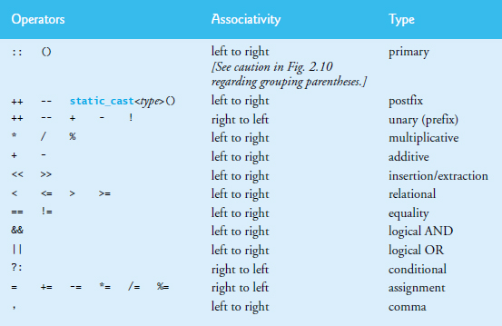
Figure 5.19 Operator Precedence and Associativity

Slide 126
5.12 Confusing the Equality (==) and Assignment (=) Operators (1 of 2)
Accidentally swapping the operators == (equality) and = (assignment).
Damaging because they ordinarily do not cause syntax errors.
Rather, statements with these errors tend to compile correctly and the programs run to completion, often generating incorrect results through runtime logic errors.
[Note: Some compilers issue a warning when = is used in a context where == typically is expected.]
Two aspects of C++ contribute to these problems.
One is that any expression that produces a value can be used in the decision portion of any control statement.
The second is that assignments produce a value—namely, the value assigned to the variable on the left side of the assignment operator.

Slide 127
5.12 Confusing the Equality (==) and Assignment (=) Operators (2 of 2)
Any nonzero value is interpreted as true.
Variable names are said to be lvalues (for “left values”) because they can be used on the left side of an assignment operator.
Constants are said to be rvalues (for “right values”) because they can be used on only the right side of an assignment operator.
Lvalues can also be used as rvalues, but not vice versa.

Slide 128
Error-Prevention Tip 5.9
Programmers normally write conditions such as x == 7 with the variable name (an lvalue) on the left and the literal (an rvalue) on the right. Placing the literal on the left, as in 7 == x, enables the compiler to issue an error if you accidentally replace the == operator with = . The compiler treats this as a compilation error, because you can’t change a literal’s value.

Slide 129
Common Programming Error 5.9
Using operator == for assignment and using operator = for equality are logic errors.

Slide 130
Error-Prevention Tip 5.10
Use your text editor to search for all occurrences of = in your program and check that you have the correct assignment. relational or equality operator in each place.

Slide 131
5.13 Structured Programming Summary (1 of 2)
We’ve learned that structured programming produces programs that are easier than unstructured programs to understand, test, debug, modify, and even prove correct in a mathematical sense.
Figure 5.20 uses activity diagrams to summarize C++’s control statements.
The initial and final states indicate the single entry point and the single exit point of each control statement.

Slide 132
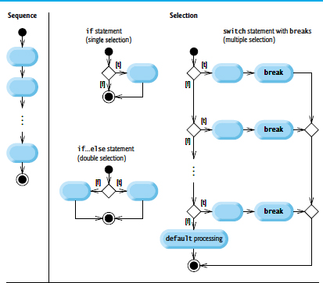
Figure 5.20 C++’s Single-Entry/Single-Exit Sequence, Selection and Iteration Statements (1 of 2)

Slide 133
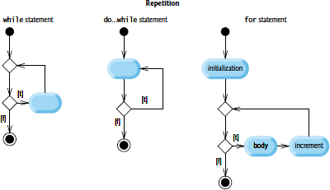
Figure 5.20 C++’s Single-Entry/Single-Exit Sequence, Selection and Iteration Statements (2 of 2)

Slide 134
5.13 Structured Programming Summary (2 of 2)
Figure 5.21 shows the rules for forming structured programs.
The rules assume that action states may be used to indicate any action.
The rules also assume that we begin with the so-called simplest activity diagram (Figure 5.22), consisting of only an initial state, an action state, a final state and transition arrows.
Applying the rules of Figure 5.21 always results in an activity diagram with a neat, building-block appearance.
Rule 2 generates a stack of control statements, so let’s call Rule 2 the stacking rule.
Rule 3 is the nesting rule.

Slide 135
Figure 5.21 Rules for Forming Structured Programs
Rules for forming structured programs
Begin with the simplest activity diagram (Figure 5.22).
Any action state can be replaced by two action states in sequence.
Any action state can be replaced by any control statement (sequence of action states, if, if…else, switch, while, do…while or for).
Rules 2 and 3 can be applied as often as you like and in any order.

Slide 136
Figure 5.22 Simplest Activity Diagram

Slide 137
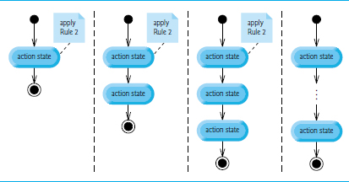
Figure 5.23 Repeatedly Applying Rule 2 of Figure 5.21 to the Simplest Activity Diagram

Slide 138
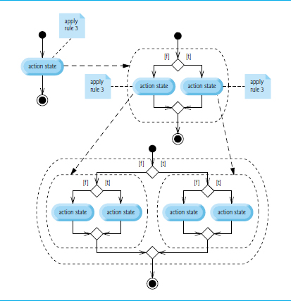
Figure 5.24 Repeatedly Applying Rule 3 of Figure 5.21 to the Simplest Activity Diagram

Slide 139
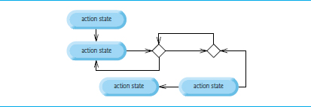
Figure 5.25 “Unstructured” Activity Diagram

Slide 140

Copyright

